Slide 1
AIRFRAME CFD ANALYSIS
REPORT
Why CFD?
Numerically solve fluids problems.
Detailed info about pressure, velocity, temperature distributions.
Approximate lift and drag forces.
Update our OpenRocket data for more accurate flight simulations.
Reduces effort and cost by avoiding physical experiments.

Slide 2
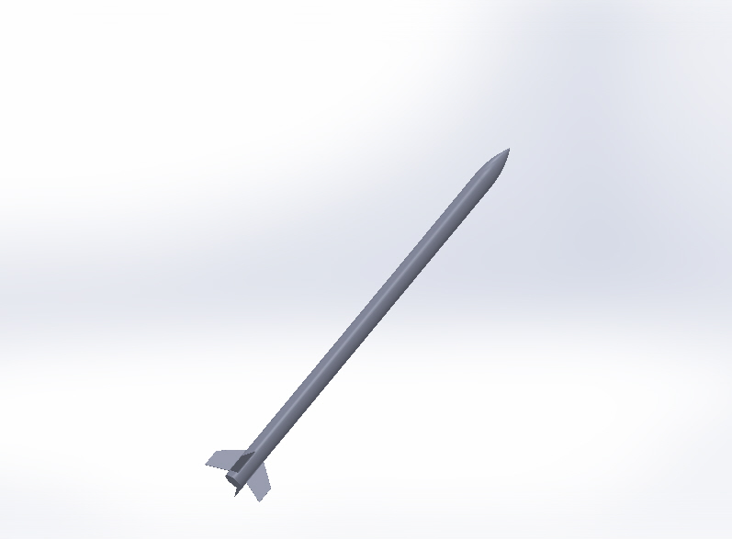
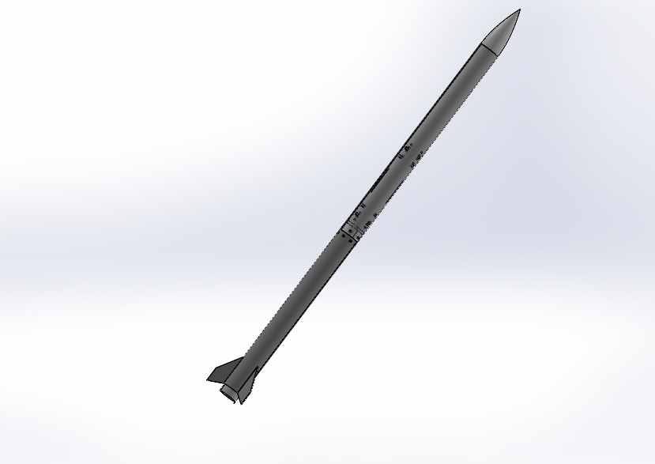
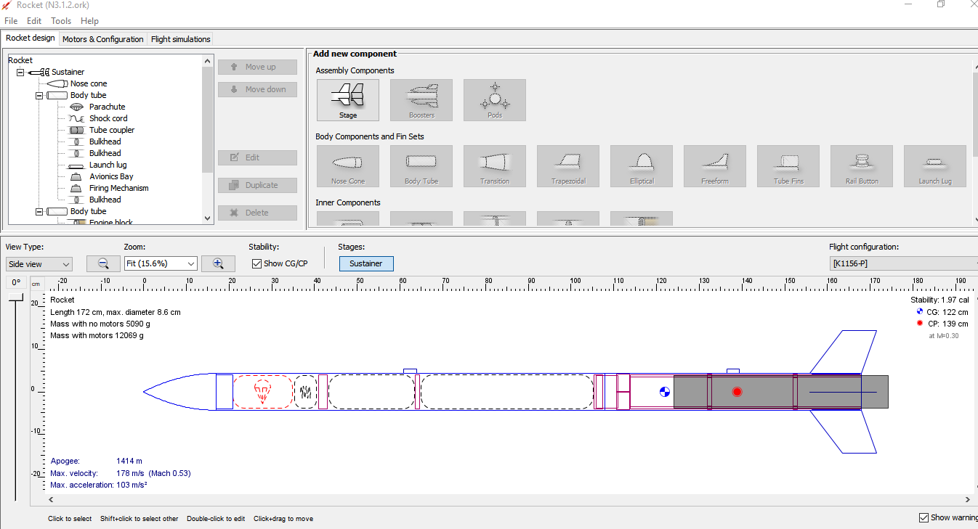
Design Workflow
OpenRocket (2D)
.ork file
SolidWorks (3D)
.STEP file
Clean-up
SolidWorks
.STEP file

Slide 3
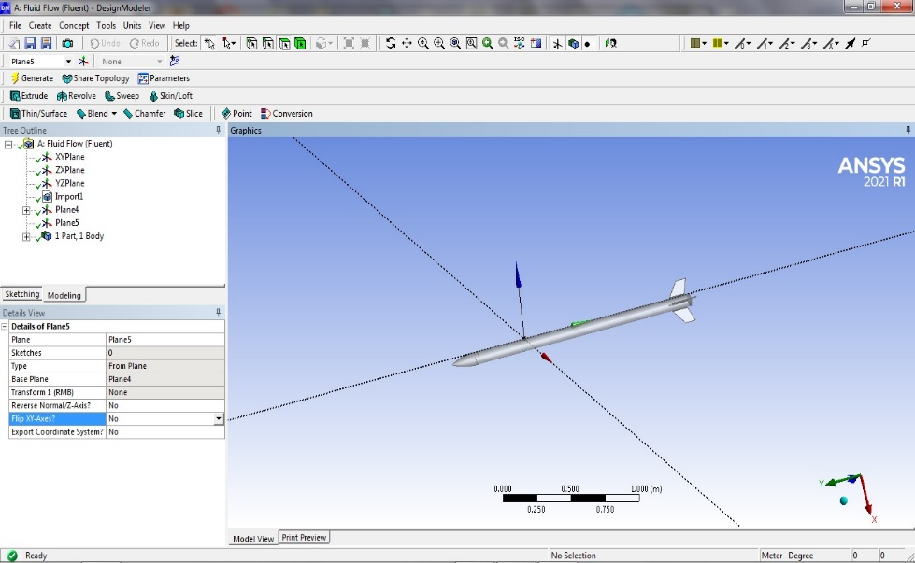
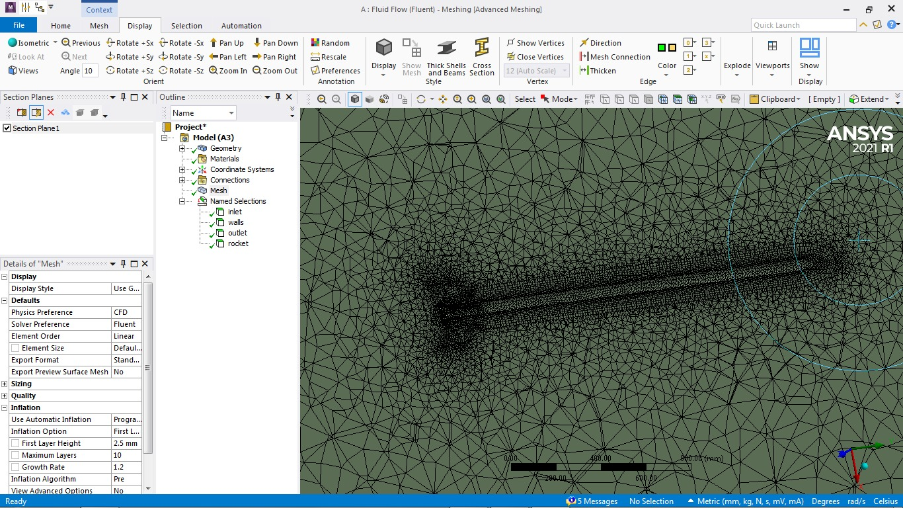
SolidWorks
.STEP file (Simplified)
Export
Design Modeler
.STEP file
Import to
Fluent
Fluent (mesher)
.msh file

Slide 4
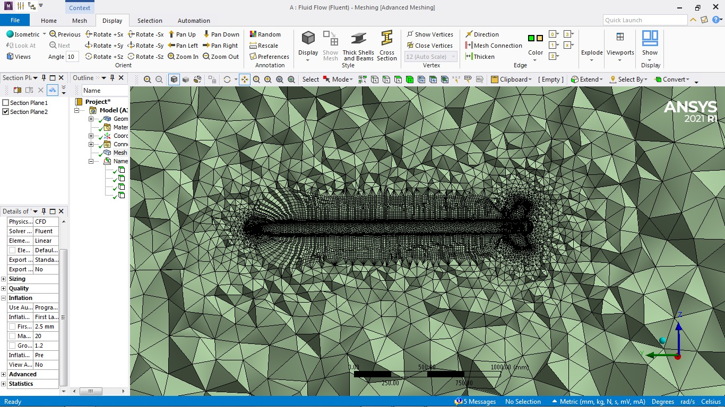
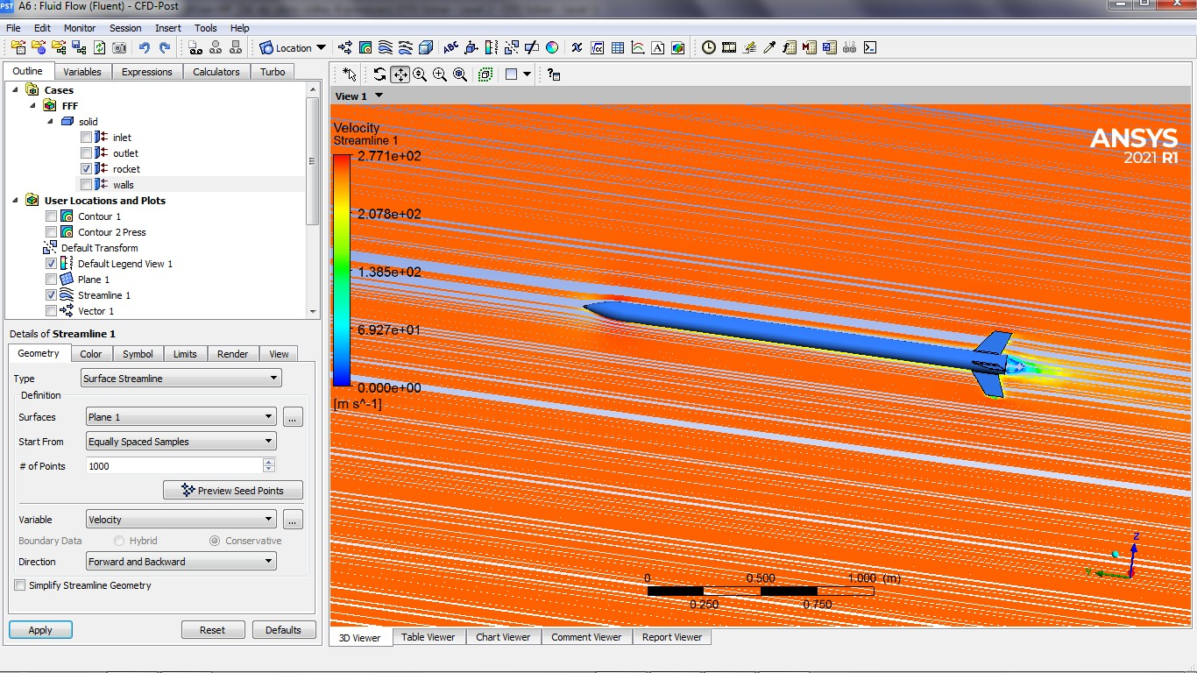
Fluent (mesher)
.msh file
Read Mesh
Fluent (solver)

Slide 5
Preparing Geometry
CFD can’t handle complex geometry, need to simplify the geometry for CFD
Cleanup
Small faces, manufacturing features
Fillets, chamfers, rounds

Slide 6
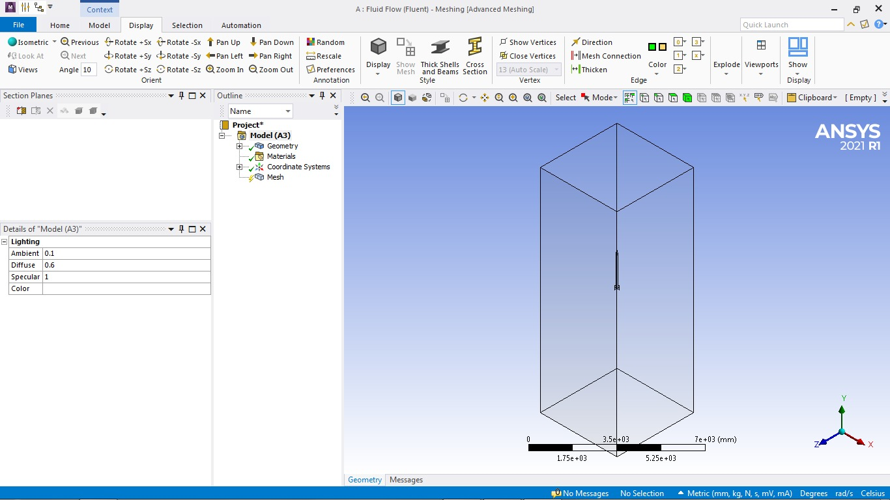
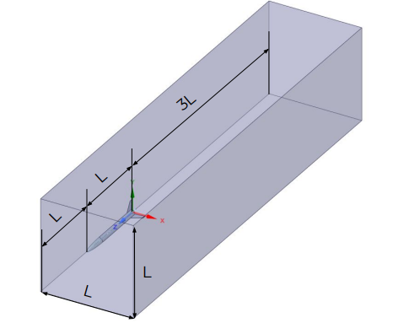
Enclosure
L - length of the model
Inlet - large enough to not be affected by stagnation region
Outlet - large enough to capture the wake (behind the rocket) and turbulent regions
Note that the enclosure doesn’t include the rocket - only the air around it
Rule of thumb
Actual Rocket in the enclosure

Slide 7
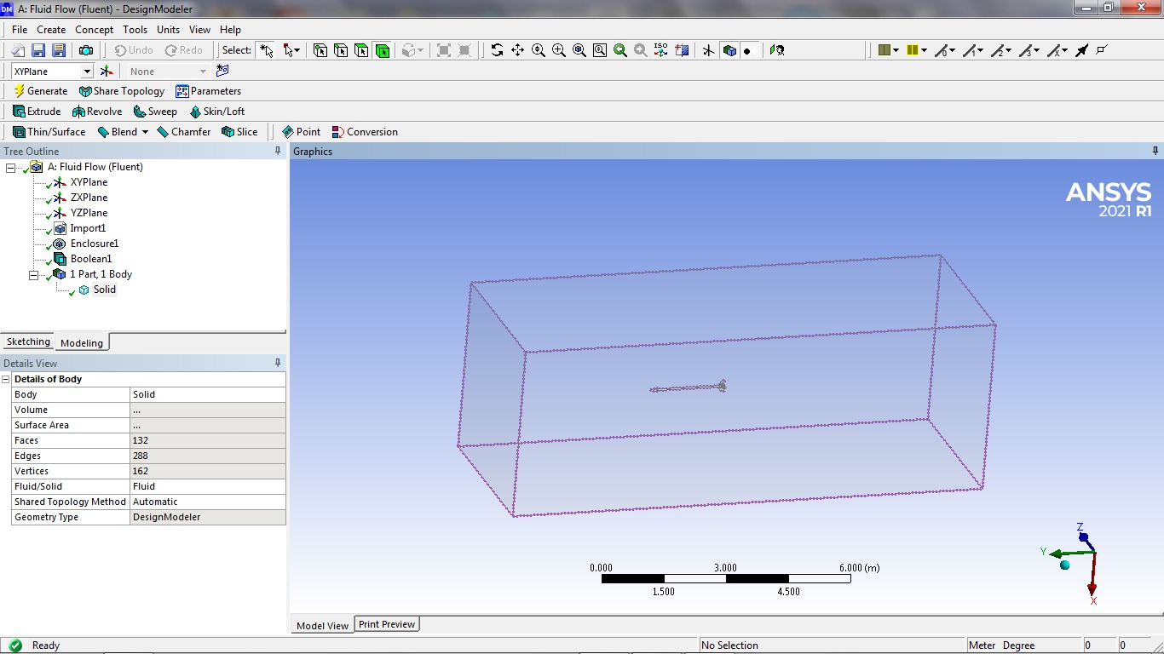
Note that the enclosure doesn’t include the rocket - only the air around it.
So what do we do?
Suppress for physics!!
The rocket is a solid.
The enclosure is a fluid pool.
CFD only wants to model the fluids.
Suppress the rocket- so it doesn’t get passed to Fluent CFD (Boolean Subtract Operation)
Rocket Cavity

Slide 8
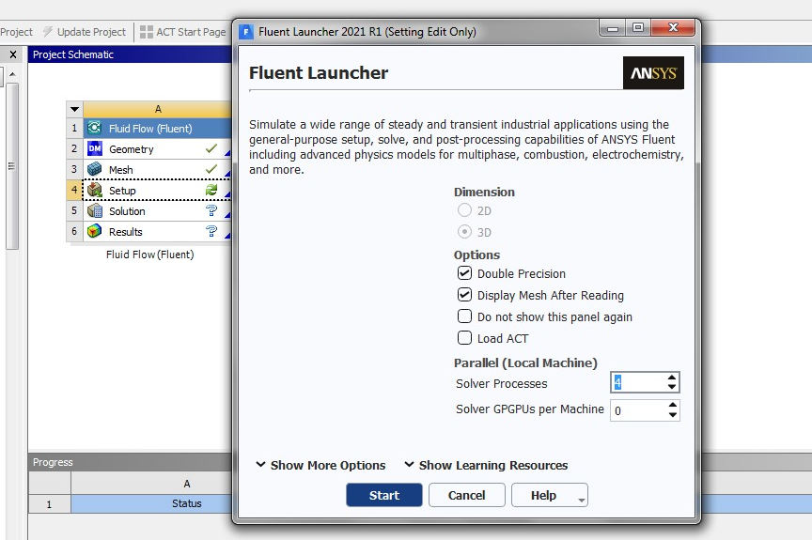
Fluent (Meshing Software)
Setting up fluent.
Number of cores that you have
Do you have a GPU?

Slide 9
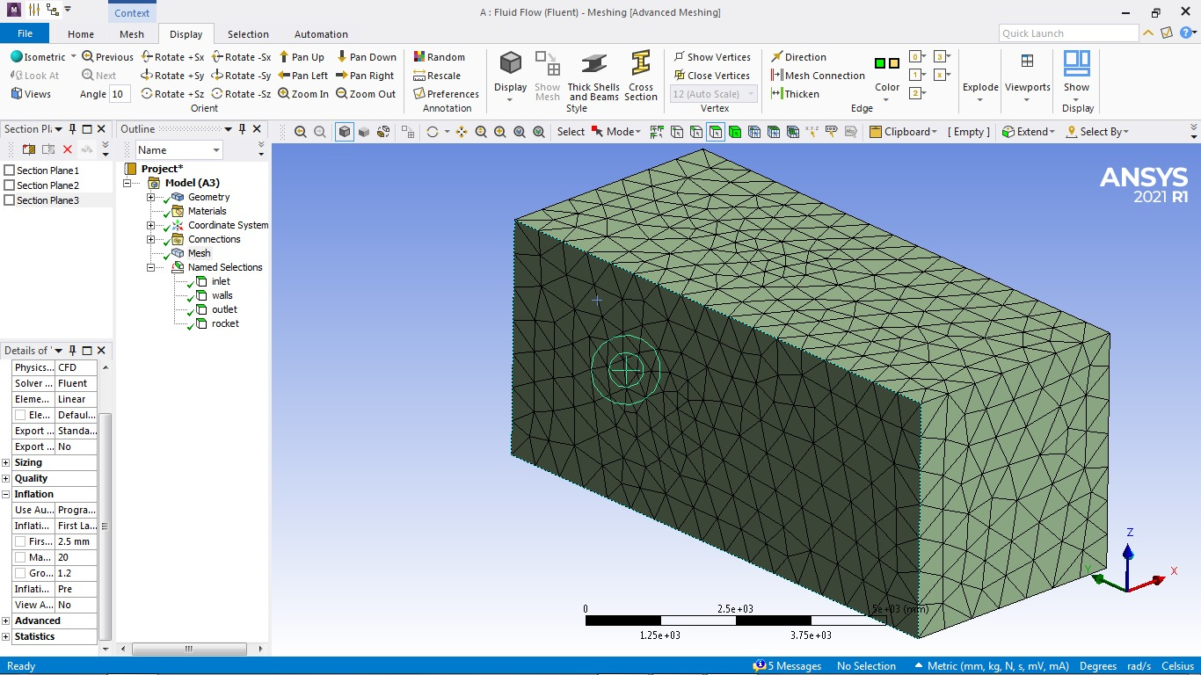
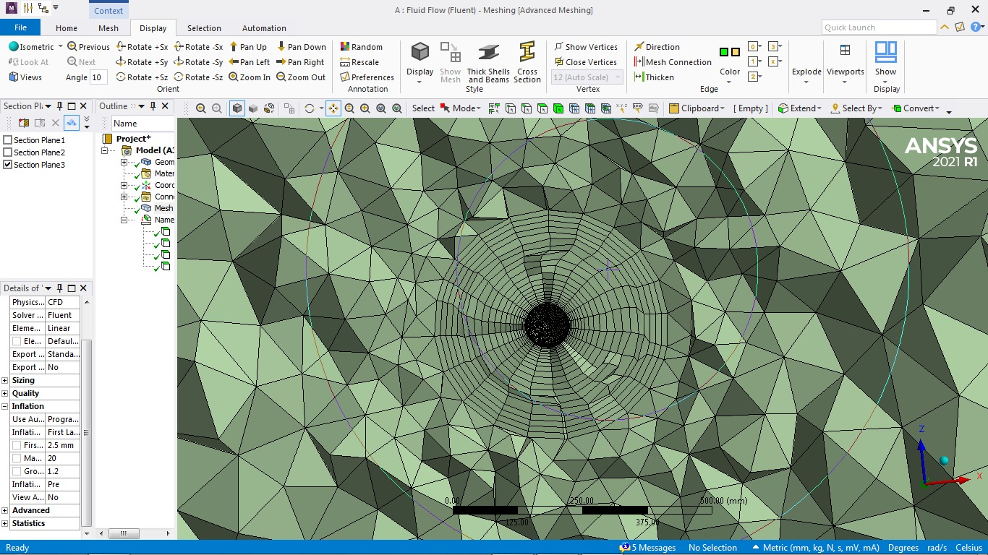
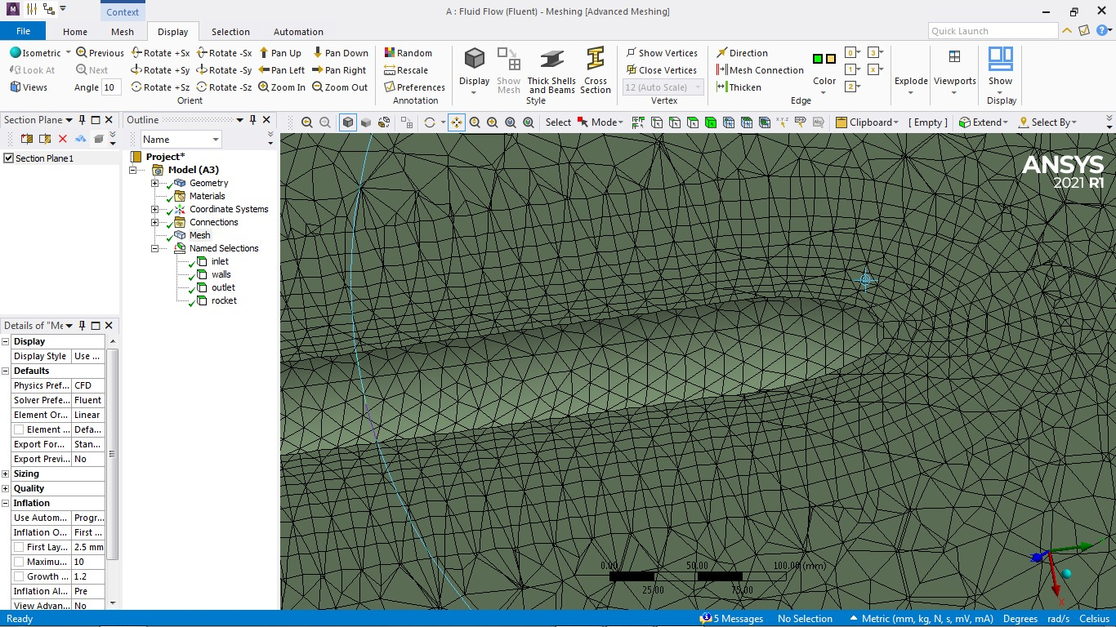
Generated Mesh
Body Tube C.S
20 inflation areas around the body
Cross-Section area around the body tube.

Slide 10
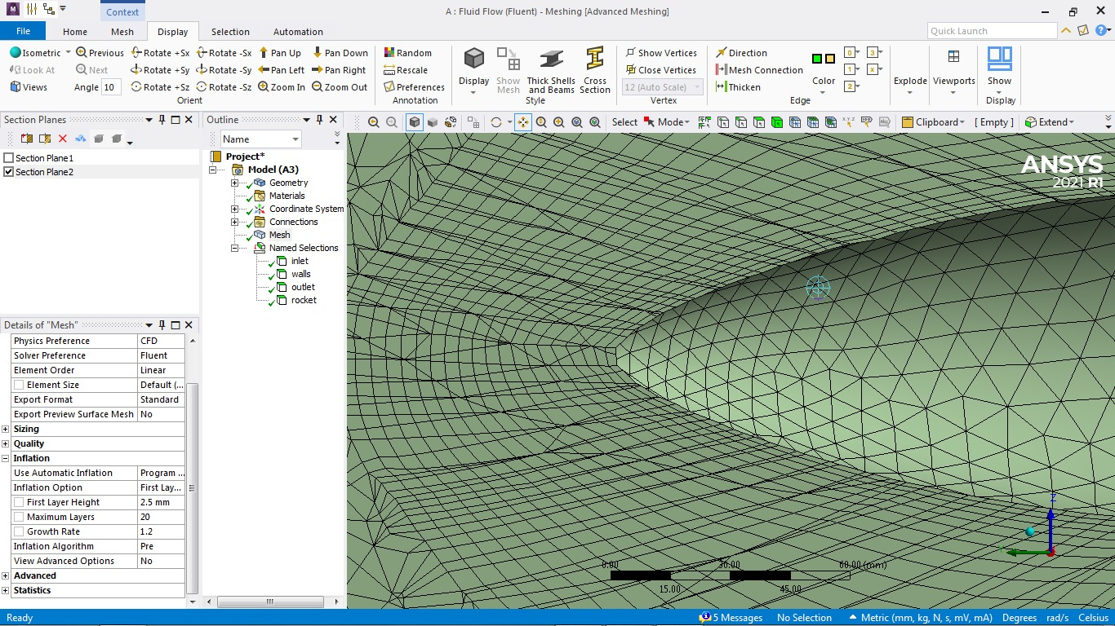
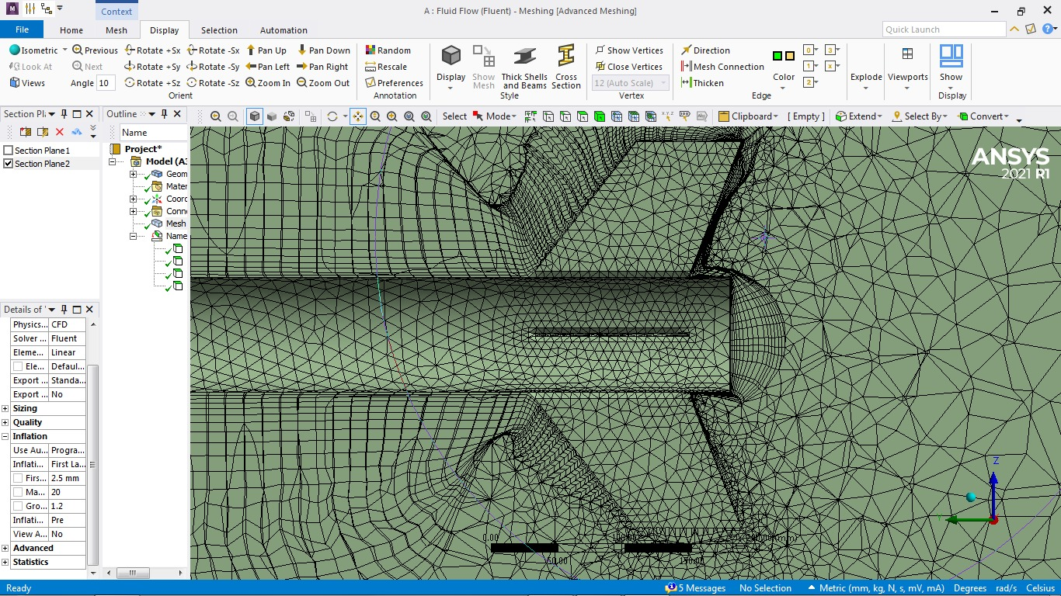
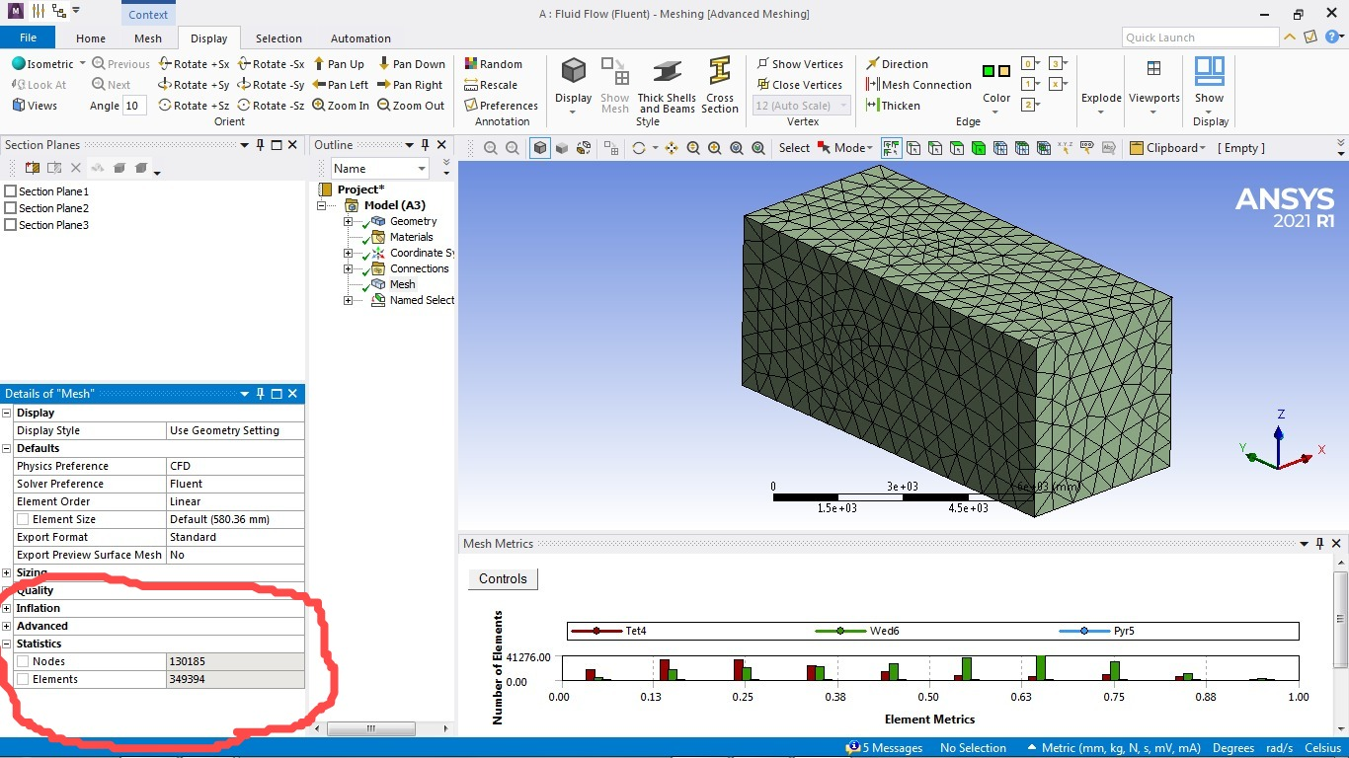
Around the nose cone area
Around the fin area
Skewness is less than 1.
Less than 0.8 is recommended
Number of elements in mesh 349,394

Slide 11
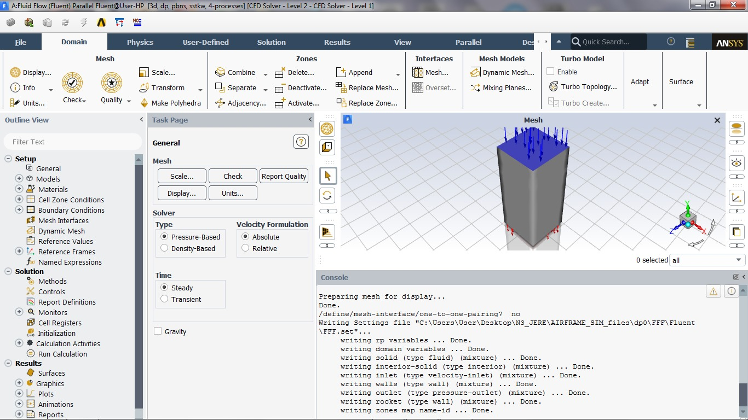
Fluent Solver
Follow these steps
one by one :)
Domain tab
Physics tab
Solution tab
Results tab

Slide 12
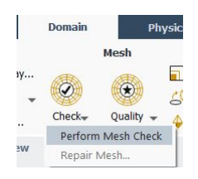
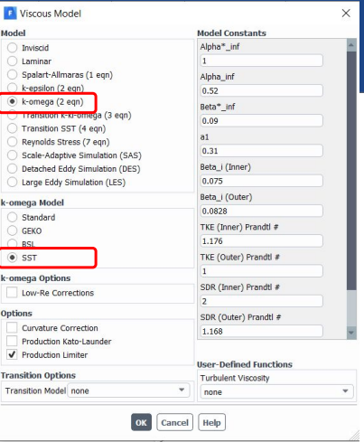
Domain Tab
PHYSICS TAB
K-Omega SST model is used
Performing Mesh Check-gave no errors.
Can also check quality here.
Boundary Conditions
Rocket surfaces - wall (stationary, no slip)
Inlet - velocity-inlet
Outlet - pressure-outlet
Outer wall - wall (moving at same velocity as inlet)

Slide 13
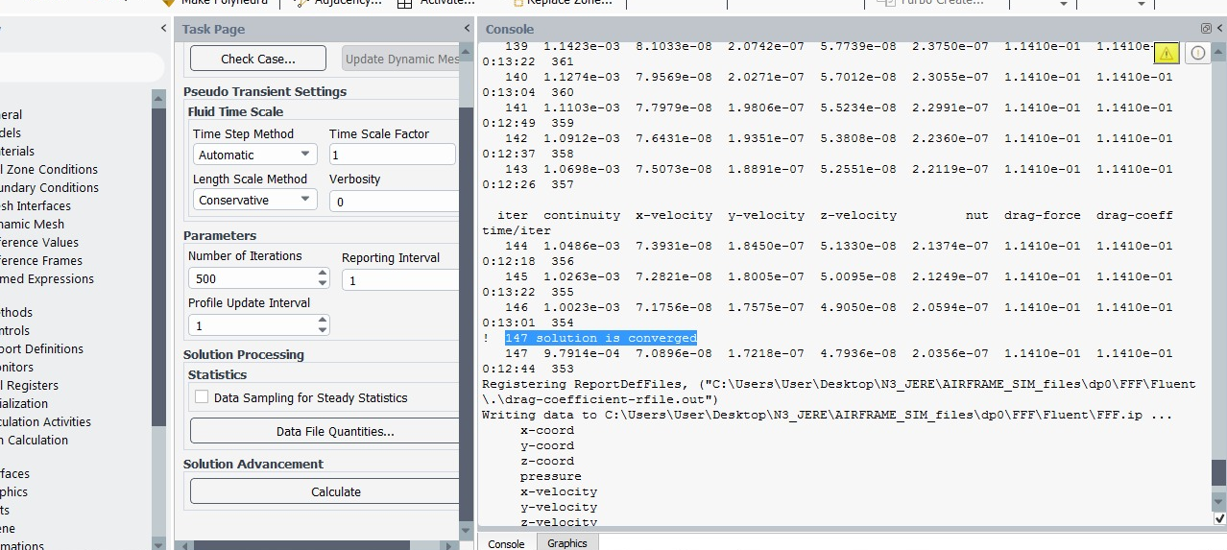
Solutions Tab
Always initialize first. Set iterations to 500 and hit Calculate.
Residuals
Residuals should decrease by a factor of 10^3 in order to stabilize for convergent solution
Solution converged at 147 iteration

Slide 14
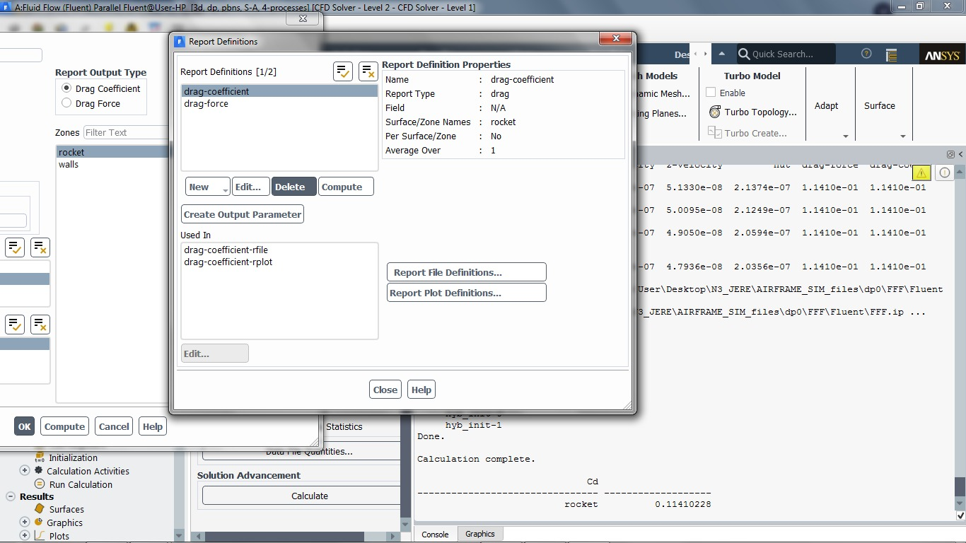
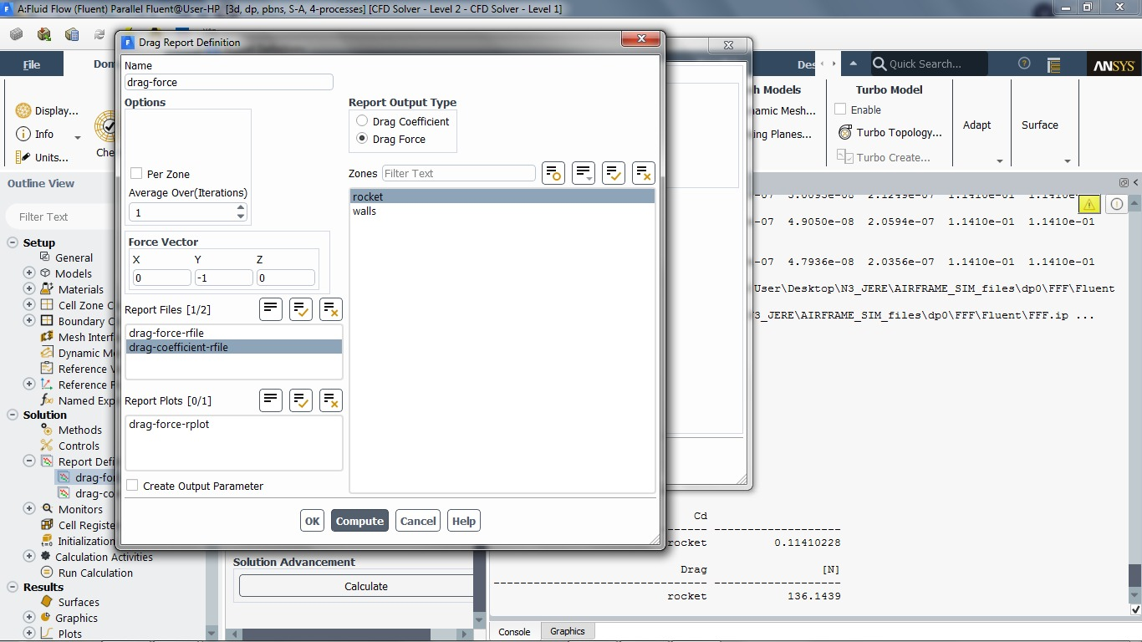
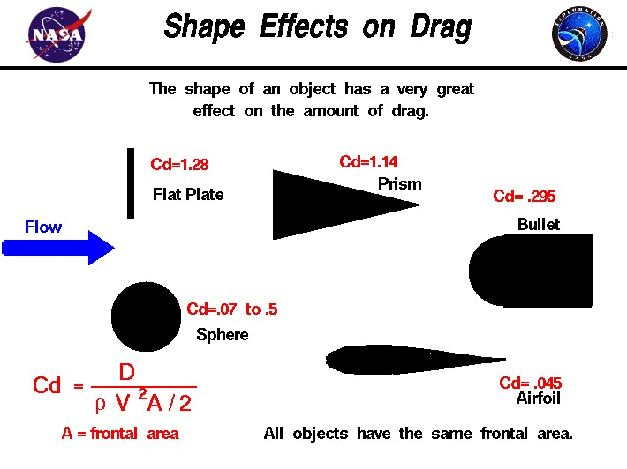
Nice low Drag Coefficient
Cd=0.14
Drag Force (in the direction of airflow)
FD=136 N
Adapted from NASA rocketry website

Slide 15
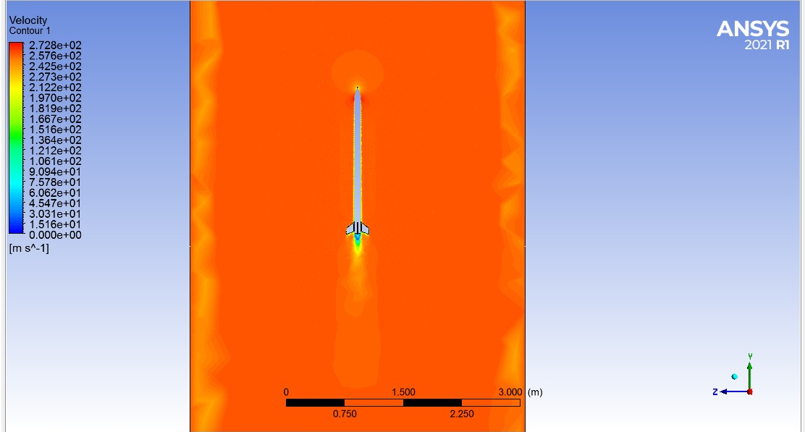
Results in CFD Post
Velocity

Slide 16
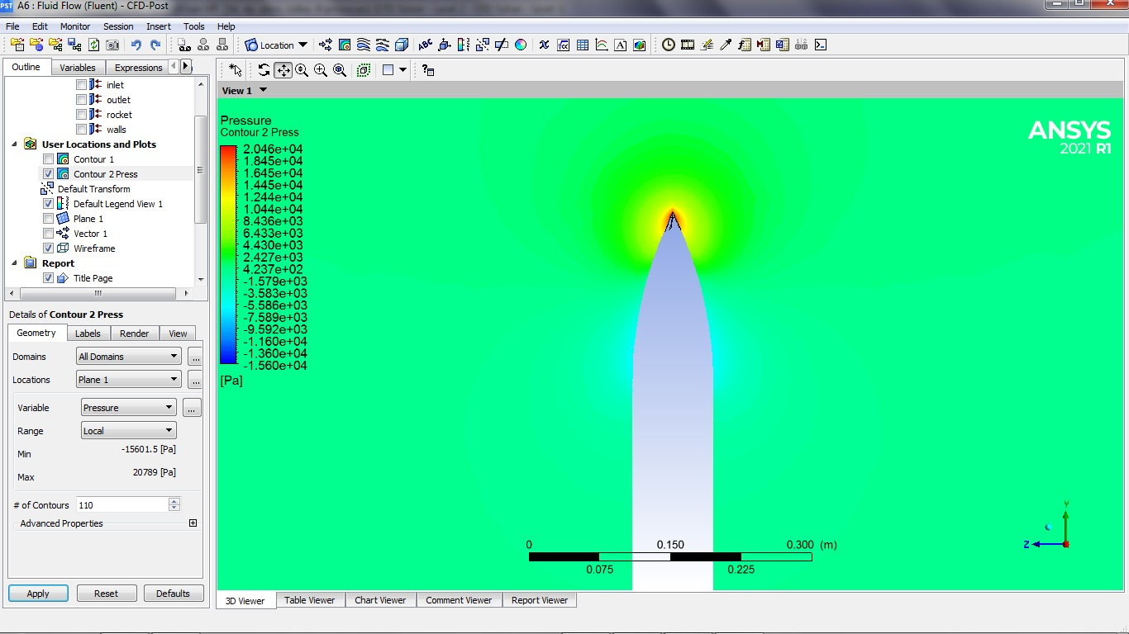
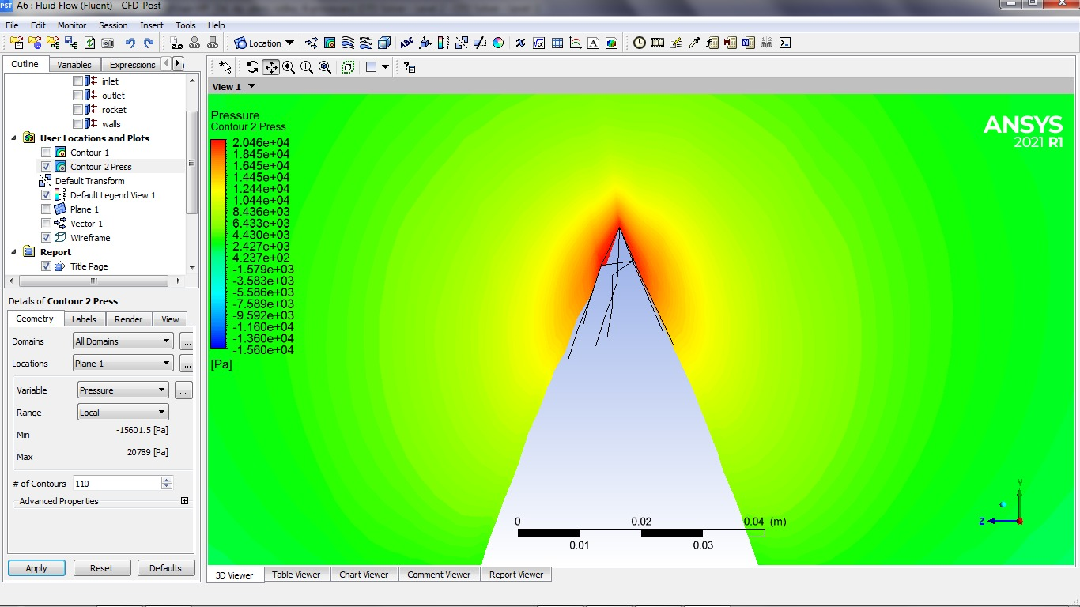
2. Pressure Contours
Nose Cone area

Slide 17
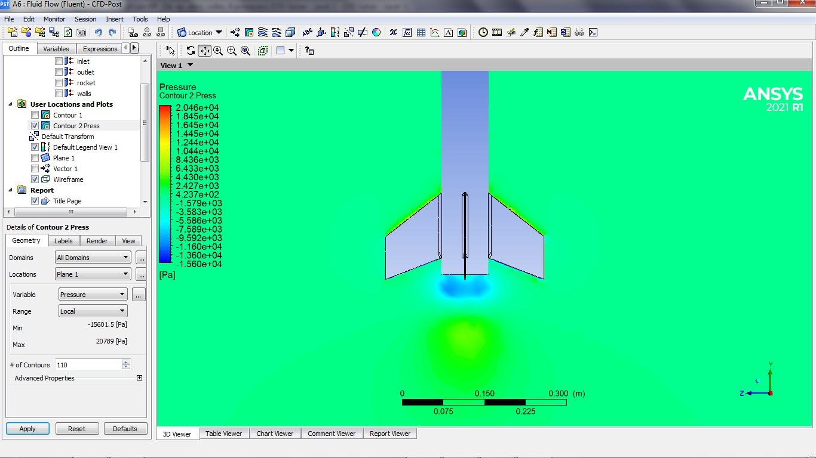
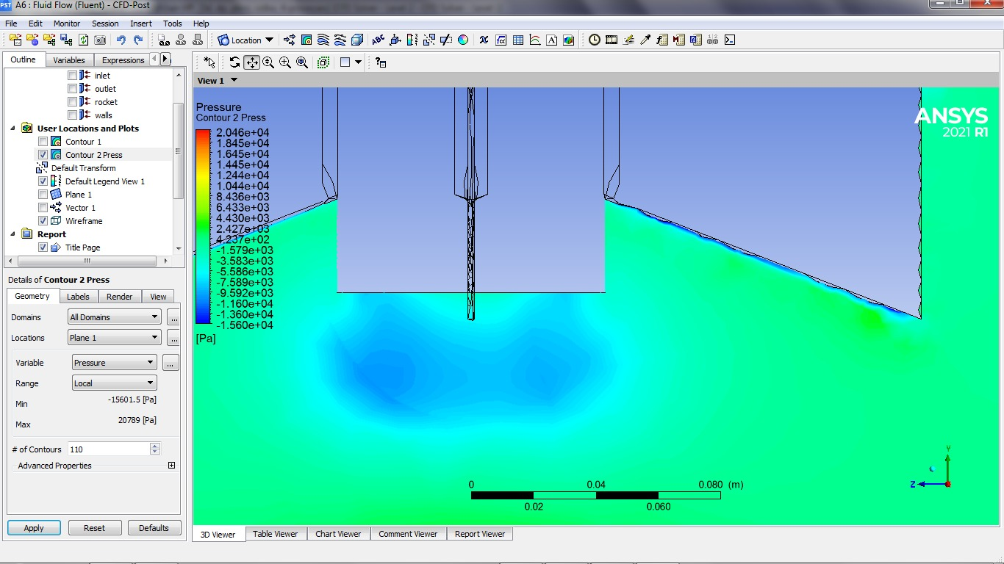
Fin area

Slide 18
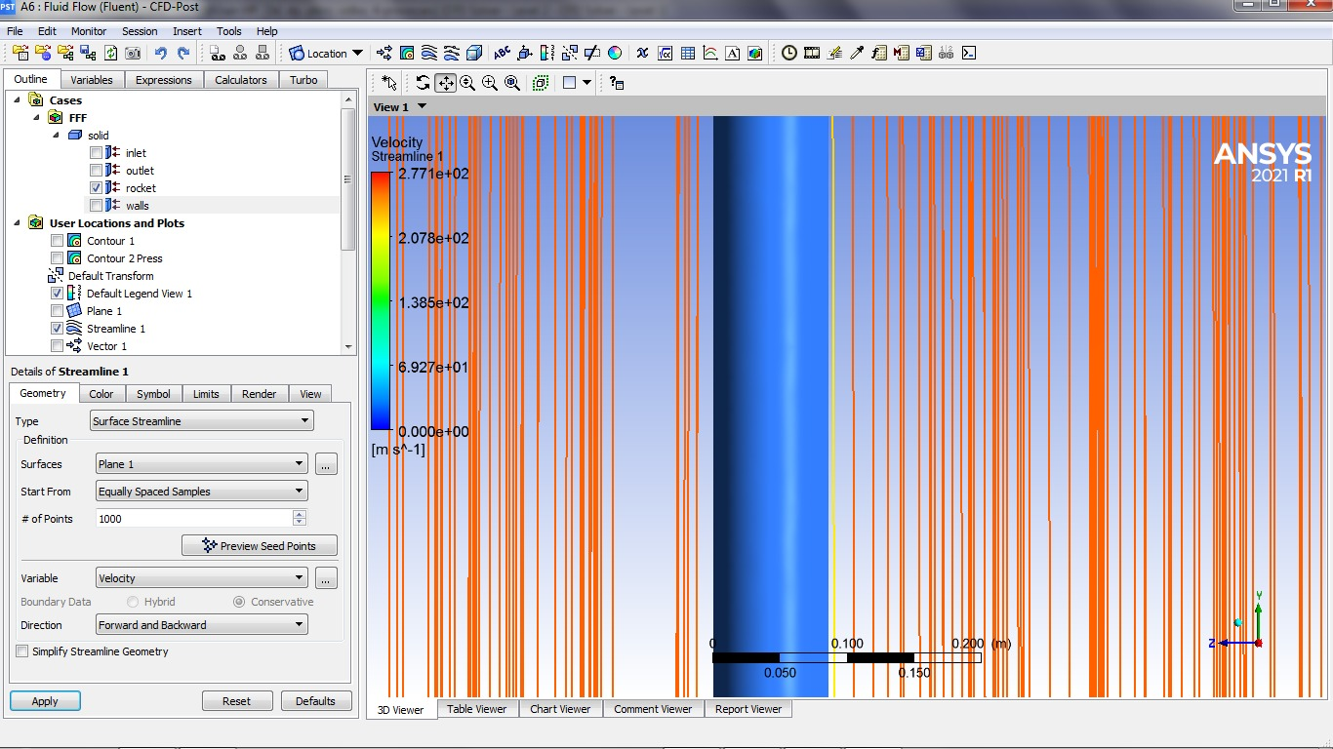
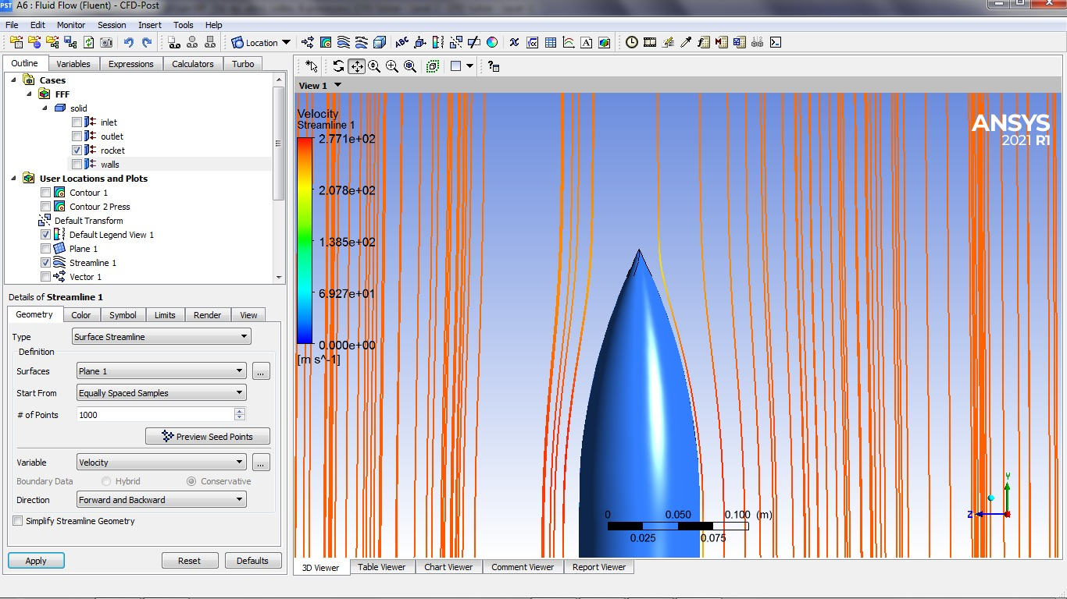
3. Streamlines
Cone area
Body tube area

Slide 19
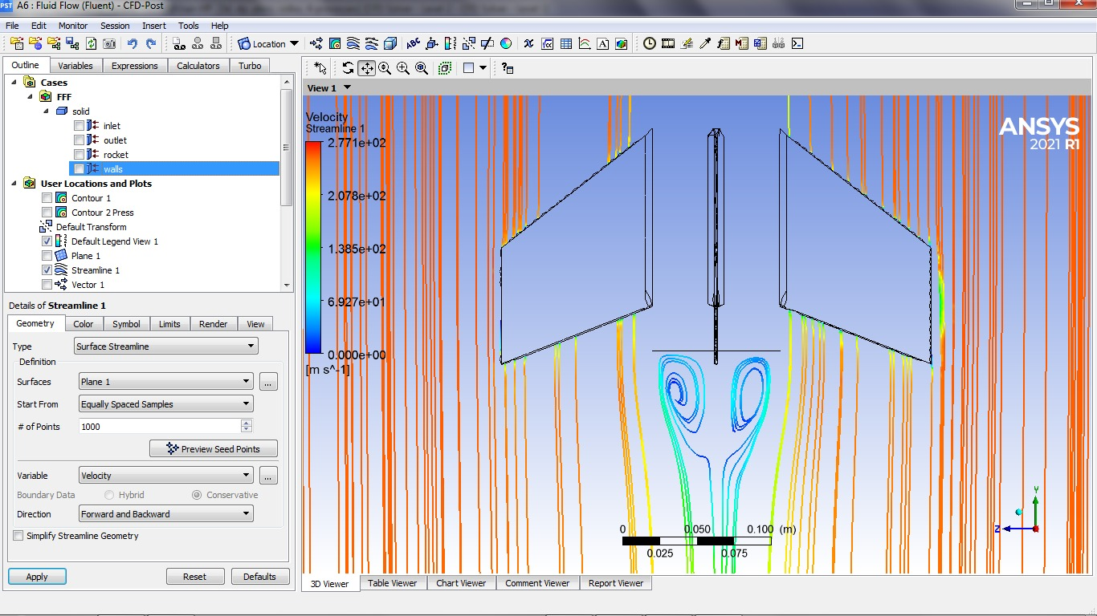
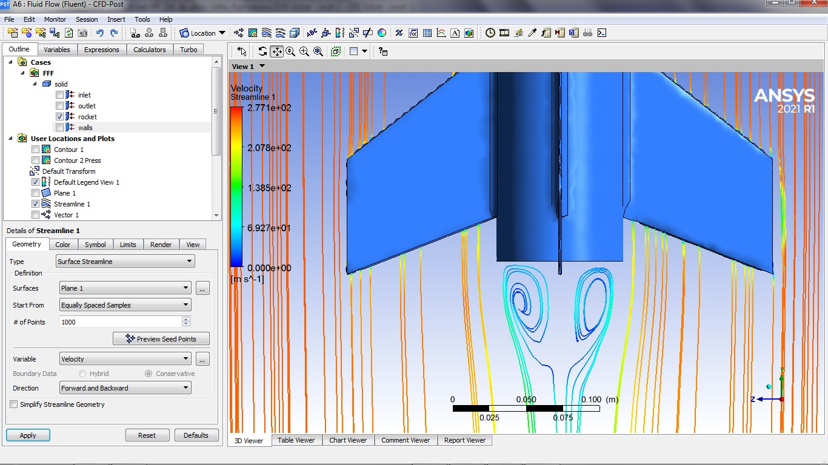
Fin area

Slide 20
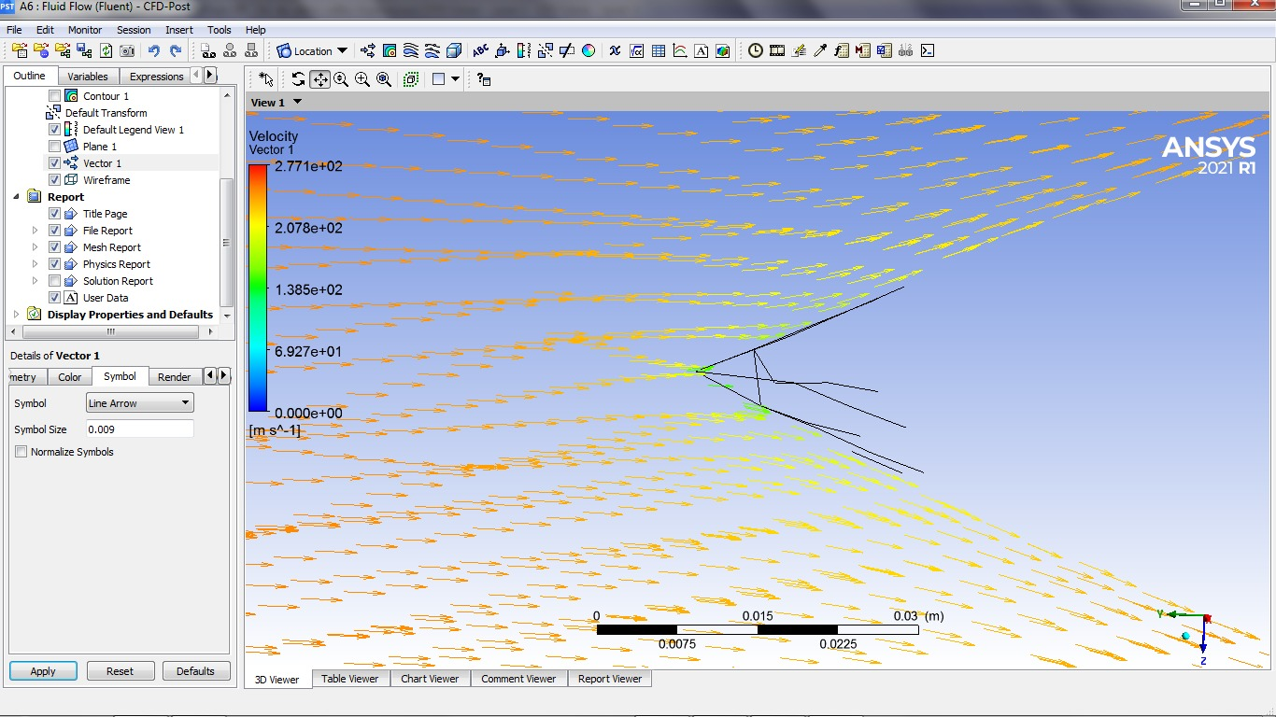
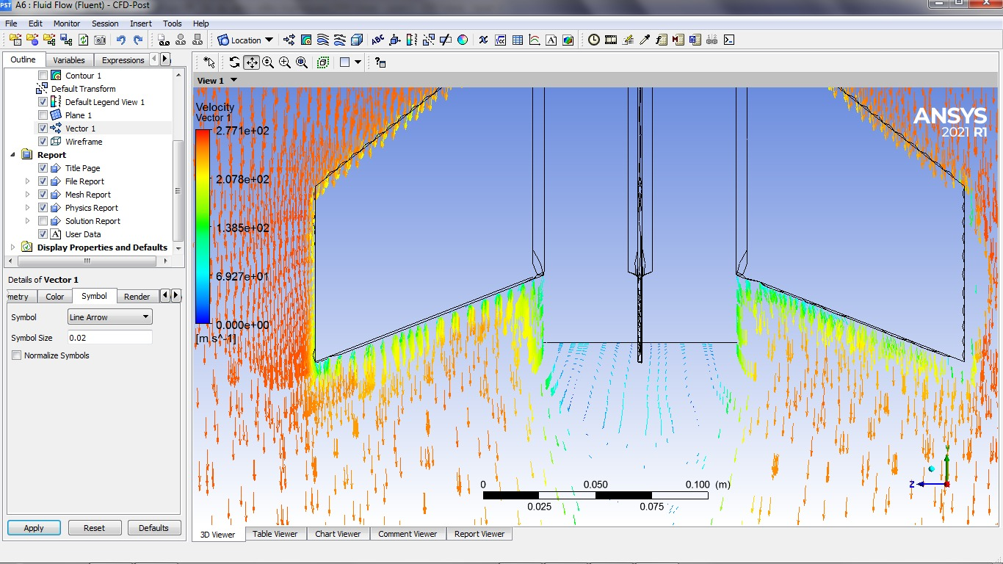
4. Vectors

